Slide 1
CYBER THREAT ANALYTICS
Machine Learning for
Cyber Threat Analytics
Intrusion Detection and Network Latency Prediction
using the UNSW-NB15 Dataset
Ashutosh Kumar Verma (Student ID: 475852)
Ramik Sharma (Student ID: 477656)

Slide 2
PROJECT STRUCTURE
Project Overview
01
Project Objectives & Methodology
04
Regression Task: Network Performance Prediction
Dual-task framework combining classification and regression with rigorous validation methodology ensuring data integrity and realistic performance estimates.
Predicting continuous network metrics including latency, throughput, and connection duration with tree-based ensemble methods and residual analysis.
02
Dataset Characteristics & Preprocessing
05
Key Findings & Insights
UNSW-NB15 dataset analysis, data quality assessment, and comprehensive preprocessing pipeline with leakage prevention.
Model comparison, operational implications for cybersecurity, and practical deployment considerations for real-world threat detection.
03
Classification Task: Intrusion Detection
Technical Highlights
Binary and multi-class threat detection models, feature importance analysis, and holdout validation on unseen network traffic data.
50K training samples
45-53 engineered features
Holdout validation
Data leakage prevention

Slide 3
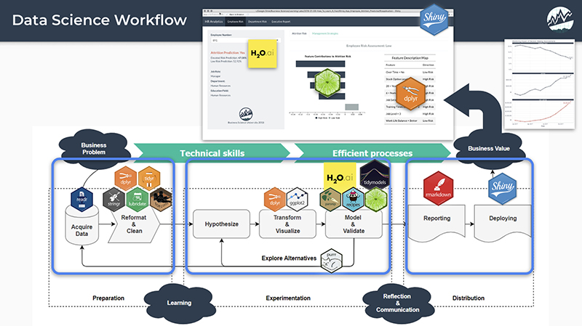
CHAPTER 01
Project Objectives
& Methodology
Defining the dual-task approach and rigorous validation framework

Slide 4
PROJECT ARCHITECTURE
Dual-Task Machine Learning Framework
Classification Task
Regression Task
Intrusion Detection
Network Performance Prediction
Binary Classification
Prediction Targets
Objective: Distinguish between benign and malicious network traffic with high recall to minimize missed attacks.
Objective: Predict 8 continuous network performance metrics to support proactive defense and capacity planning.
Target: Label (0 = Normal, 1 = Attack)
Connection Duration
Bytes Transferred
Throughput (bps)
TCP Timing Metrics
Multi-Class Classification
Objective: Categorize malicious traffic into 9 specific attack types for enhanced threat intelligence.
Evaluation Metrics
RMSE
MAE
Exploits
Generic
Fuzzers
R² (Coefficient)
Cross-Validation
Reconnaissance
DoS
Shellcode
Evaluation Metrics
Practical Applications
Recall (Priority)
Precision
F1-Score
ROC-AUC
Real-time Threat Detection: Deploy classification models for immediate security alerts.
Performance Monitoring: Use regression residuals as anomaly indicators.

Slide 5
VALIDATION FRAMEWORK
Methodological Rigor & Data Integrity
1
Memory-Efficient Loading
2
Duplicate Detection
3
Leakage Prevention
Strategy: 3+1 file approach streams large dataset files to manage memory.
Finding: 22.02% duplicate rate in training data.
Systematic Review: Multi-stage analysis to identify and remove features that leak target information.
Training:
Files 1-3 (~2.1M)
Original:
110,072
Temporal: Stime, Ltime
Holdout:
File 4 (~440K)
Deduplicated:
85,839
Correlation: r > 0.95
Final Sample:
50K records
Final Sample:
49,997
Semantic: Suspicious names
Holdout data is untouched.
Duplicates can inflate performance.
Manual review confirmed 3 removals.
Cross-Validation Strategy
Holdout Validation
Setup: 5-fold CV on training data for model selection, with stratified sampling to maintain class distribution, ensuring unbiased error estimation before holdout validation.
Final Test: File 4 (10K samples) provides a true generalization estimate. The 60 overlapping records found represent minimal leakage (0.6%), confirming data separation integrity.

Slide 6

CHAPTER 02
Dataset Characteristics
& Preprocessing
UNSW-NB15 dataset features and comprehensive data preparation pipeline

Slide 7
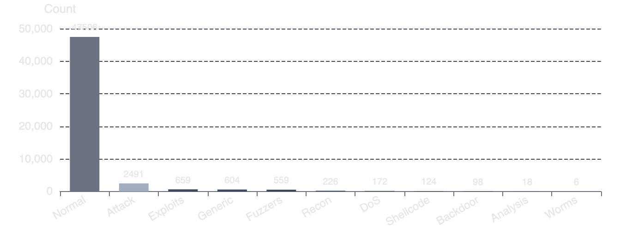
DATA SOURCE
UNSW-NB15 Dataset Profile
Dataset Specifications
Classification Target Distribution
Total Records
~2.5 Million
Distributed across 4 CSV files
Training Sample
49,997
After deduplication & stratified sampling
Holdout Validation
10,000
Binary Classes
Multi-Class Imbalance
Unseen File 4 samples
Normal:
47,506 (95.02%)
Exploits: 659 (1.32%)
Attack:
2,491 (4.98%)
Generic: 604 (1.21%)
Fuzzers: 559 (1.12%)
Feature Evolution
Reconnaissance to Worms: 0.45% to 0.002%
Original:
49
After Leakage Removal:
45
After Engineering:
53
After Selection:
20
Feature Categories (49 → 45 → 53 → 20)
Flow Statistics: duration, bytes, packets
Protocol Info: TCP, UDP, ICMP, state
Behavioral: TTL, RTT, window sizes
Statistical: jitter, load metrics, rates

Slide 8
DATA PREPROCESSING PIPELINE
Data Quality & Leakage Prevention Pipeline
1
Memory-Efficient Loading
4
Feature Engineering
Stream processing of large CSV files with chunked reading and garbage collection to manage memory footprint (~28MB).
Creation of domain-informed derived features capturing network behavior patterns.
total_bytes: sbytes + dbytes
Total records processed:
~2.5M
byte_ratio: sbytes / (dbytes + ε)
Memory usage:
28.34MB
total_packets: Spkts + Dpkts
packet_ratio: Spkts / (Dpkts + ε)
2
Missing Value Analysis
Systematic identification and imputation of missing values using training-data statistics to prevent leakage.
5
Categorical Encoding
Label encoding of nominal features with fitted encoders applied to validation data.
attack_cat:
91.8% missing
srcip:
35 categories
is_ftp_login:
23.7% missing
dstip:
41 categories
ct_flw_http_mthd:
22.2% missing
dsport:
12,859 categories
proto:
8 categories
3
Data Leakage Analysis
Three-stage screening to identify features that encode post-event information or would be unavailable at prediction time.
Temporal: Stime, Ltime flagged
Correlation: Dpkts (r=0.953) flagged
Result: 3 features removed after manual review
Preprocessing Pipeline Summary
1
Loading
2
Deduplication
3
Missing Value Imputation
4
Leakage Analysis
5
Feature Engineering
6
Categorical Encoding

Slide 9
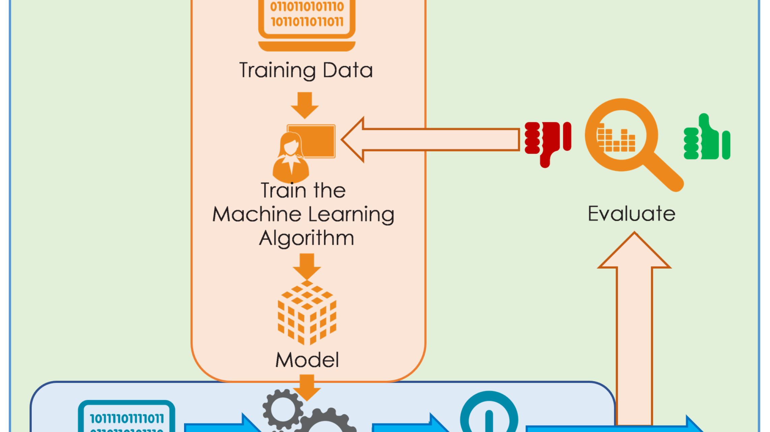
CHAPTER 03
Classification Task:
Intrusion Detection
Binary and multi-class threat detection model development and evaluation

Slide 10
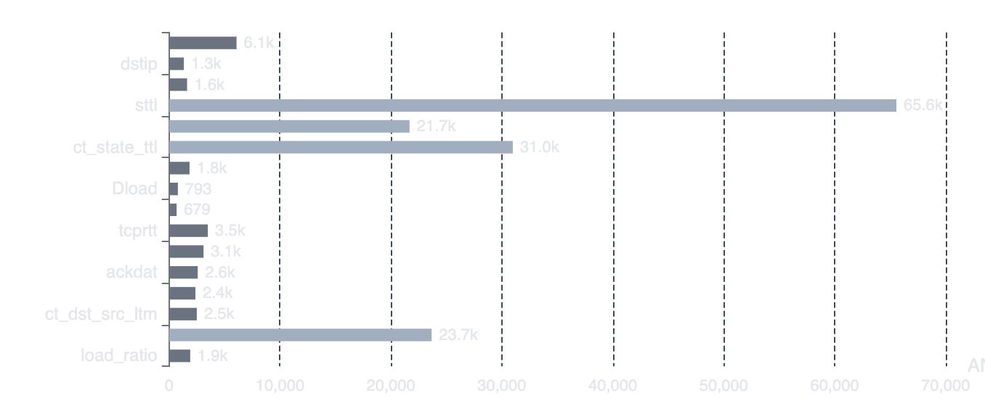
MODEL DEVELOPMENT
Classification Models & Feature Selection
Machine Learning Models
Top Selected Features by ANOVA F-score
Logistic Regression
Linear baseline for interpretability
Random Forest Classifier
Ensemble method with feature importance
XGBoost / LightGBM
Gradient boosting for superior performance
Feature Selection Strategy
Method: SelectKBest with ANOVA F-test scoring to select top 20 features.
Evaluation Strategy
Cross-Validation
Key Insights
Emphasis: Recall prioritization due to high cost of false negatives in cybersecurity contexts.
5-fold stratified CV
Dominance: TTL-related features show exceptional predictive power.
51 → 20
Hyperparameter tuning
Random state = 42
Features after selection

Slide 11
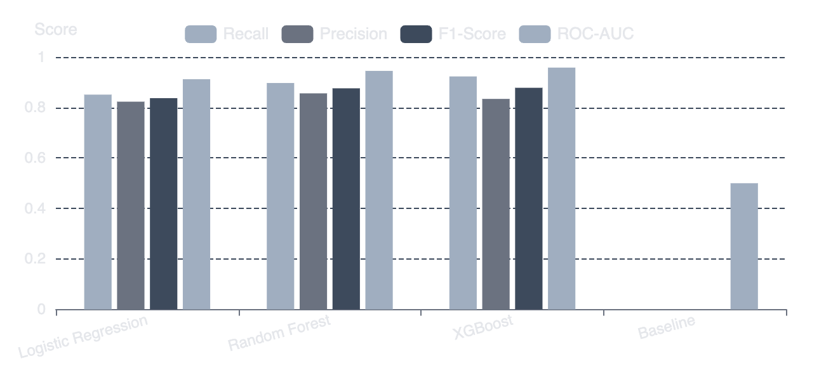
CLASSIFICATION PERFORMANCE
Binary Classification: Benign vs Malicious
Model Performance Comparison (Cross-Validation)
Dataset Characteristics
Class Distribution
Normal:
95.02%
Attack:
4.98%
Training Set
49,997 samples
After deduplication
Top Predictive Features
1
sttl: 65,563
2
ct_state_ttl: 30,982
Performance Analysis
3
dttl: 21,675
XGBoost achieves superior recall (92.3%) while maintaining strong precision. Random Forest shows balanced F1-score. All models significantly outperform the majority class baseline.
4
ttl_diff: 23,665
Holdout Validation
Final evaluation on 10,000 unseen samples from File 4 confirms generalization.
Minimal overlap (60 records, 0.6%)

Slide 12
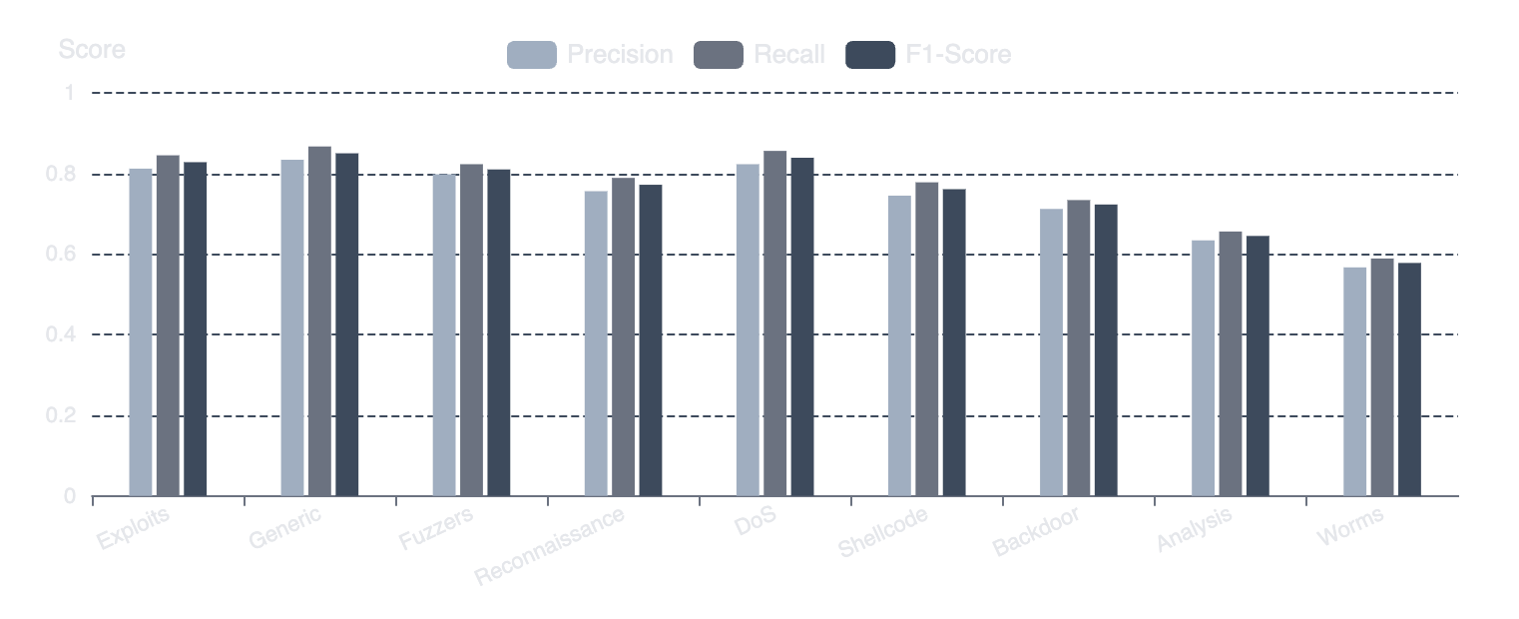
MULTI-CLASS DETECTION
Multi-Class Classification: Attack Category Detection
Attack Categories
Model Performance (Macro-Averaged)
Nine distinct attack types with severe class imbalance, requiring recall-focused evaluation.
1. Exploits:
659 (1.32%)
2. Generic:
604 (1.21%)
3. Fuzzers:
559 (1.12%)
4. Reconnaissance:
226 (0.45%)
5-9. Others:
324 (0.65%)
Challenge: Class Imbalance
Feature Importance
Holdout Validation
Problem: Some classes have <1% of the data. Solution: Stratified sampling & recall-focused evaluation.
Top Features: Similar to binary (TTL, load, state), effective across all attack types.
Result: Confirmed generalization to unseen attack patterns, with minimal performance degradation.

Slide 13
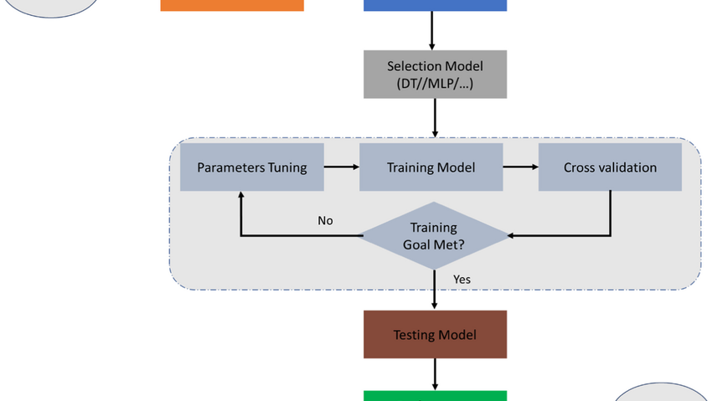
CHAPTER 04
Regression Task:
Network Performance Prediction
Predicting continuous network metrics for proactive defense and capacity planning

Slide 14
REGRESSION FRAMEWORK
Regression Targets & Model Selection
Regression Targets
Target Variable Characteristics
Eight continuous network metrics for performance prediction and anomaly detection.
dur
sbytes
dbytes
Sload
6.8s
4.8K
39K
18M
dur: Connection duration (seconds)
Mean
Mean
Mean
Mean
sbytes: Source→destination bytes
Dload
tcprtt
synack
ackdat
2.6M
7.9ms
4.2ms
3.8ms
dbytes: Destination→source bytes
Mean
Mean
Mean
Mean
Sload: Source bits per second
Machine Learning Models
Dload: Destination bits per second
Linear Regression
Decision Tree
tcprtt: TCP round-trip time
Baseline model
Interpretable rules
synack: TCP SYN-ACK time
Random Forest
XGBoost
Robust to outliers
Advanced regularization
ackdat: TCP ACK-DATA time
Evaluation & Validation
Metrics: RMSE, MAE, R²
CV: 5-fold on training
Final Test: Holdout (10K)
Seed: 42 (reproducibility)
Key Insights: Target Distributions
Target variables exhibit varying skewness and zero-inflation. Tree-based models are preferred for robustness without transformation. Timing metrics show high zero-inflation (34.8%), making prediction challenging.

Slide 15
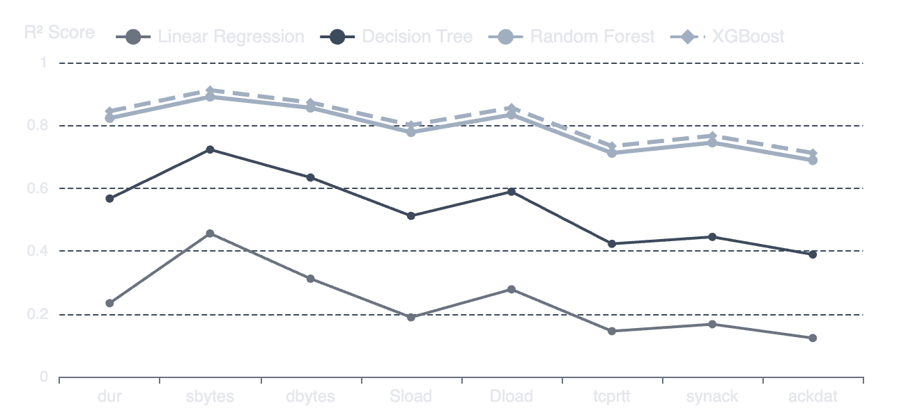
REGRESSION RESULTS
Regression Performance & Feature Importance
Model Performance Comparison (R² Score)
Top Predictive Features
1
srcip: Source IP
2
dstip: Destination IP
3
state: Connection state
4
sttl: Source TTL
5
tcprtt: TCP RTT
Cross-Validated RMSE
dur:
0.89
sbytes:
1,247
Performance Analysis
Sload:
2.1M
XGBoost and Random Forest consistently outperform linear models. sbytes and dur are most predictable, while timing metrics are challenging.
Holdout Validation
Confirmation: Performance on 10K unseen samples confirms generalization.

Slide 16
ANOMALY DETECTION
Residual Analysis for Anomaly Detection
Concept: Prediction Residuals
Operational Deployment Framework
Definition: Residual = Actual - Predicted . Large residuals indicate anomalous behavior.
1
Real-time Monitoring
Predict performance & flag large deviations.
Why Residuals Work
2
Adaptive Thresholding
Detect novel attack patterns
Dynamic thresholds based on traffic profiles.
Identify network misconfigurations
Complement classification systems
3
Alert Generation
Contextual alerts with feature attribution.
Residual Distribution Analysis
4
Integrated Response
Analysis of prediction errors reveals systematic patterns for different attack types.
Combine with classification for comprehensive security.
DoS Attacks: High residuals for throughput
Complementary Detection Strategy
Reconnaissance: Elevated timing residuals
This dual-task approach provides layered security: explicit classification for known threats, and implicit anomaly detection for unknown patterns.
Exploits: Unusual byte transfer patterns

Slide 17

CHAPTER 05
Key Findings
& Insights
Critical insights, model comparisons, and practical implications

Slide 18
COMPREHENSIVE ANALYSIS
Model Performance Comparison & Insights
Key Finding 1: Model Superiority
Key Finding 2: Feature Convergence
Result: Tree-based ensemble methods consistently outperform linear models across both tasks.
Result: Top predictive features are consistent across tasks, aligning with domain knowledge.
Classification: XGBoost achieves 92.3% recall vs 85.1% for LR.
Universal Importance: sttl, ct_state_ttl, state.
Regression: XGBoost R² of 0.912 vs 0.456 for LR.
Classification-Specific: TTL features dominate.
Insight: Non-linear interactions are critical.
Regression-Specific: IP addresses are key for traffic volume.
Insight: Feature robustness validates the approach.
Key Finding 3: Data Integrity Impact
Key Finding 4: Dual-Task Synergy
Result: Deduplication and leakage prevention are critical for realistic estimates. The 22% duplicate rate and feature leaks would have inflated performance, while holdout validation reveals generalization gaps.
Result: The framework provides complementary detection: classification for known threats, and regression residuals for unknown anomalies.
Comparative Summary: Classification vs Regression Performance
Classification (XGBoost)
Regression Best R²
Holdout Validation
92.3%
0.912
10K
Recall (attacks detected)
sbytes prediction accuracy
Unseen samples tested

Slide 19
PRACTICAL APPLICATION
Cybersecurity Operational Implications
Real-time Deployment
Key Predictive Features
Insight: Top features align with network security knowledge.
Classification System
TTL Values (sttl, dttl)
Purpose: Immediate threat detection. Action: Alert/incident response.
Indicate routing anomalies or spoofing.
Connection States
Reveal scan attempts or malformed packets.
Regression Monitoring
Timing Metrics (tcprtt)
Purpose: Ongoing performance monitoring. Action: Flag deviations.
Unusual patterns indicate proxying or load balancers.
Limitations & Considerations
Integrated Workflow
Dataset may not reflect latest threats.
Purpose: Layered defense. Action: Correlate alerts for priority.
Model drift requires periodic retraining.
Real-time deployment needs optimization.
Production Deployment Considerations
Latency
Scalability
Maintenance
Interpretability
Sub-ms prediction
Horizontal scaling
Automated retraining
SHAP explanations

Slide 20
PROJECT CONCLUSION
Project Contributions
& Future Directions
This project demonstrates a rigorous, end-to-end machine learning pipeline for cyber threat analytics combining methodological integrity with practical applicability.
Key Contributions
Future Directions
Dual-Task Framework: Novel combination of classification and regression for complementary threat detection.
Real-time Deployment: Optimize models for streaming data and low-latency inference.
Methodological Rigor: Systematic data leakage prevention and holdout validation.
Concept Drift Adaptation: Handle evolving threat landscapes via online learning.
Operational Insights: Identification of key predictive features and residual-based anomaly detection.
SOAR Integration: Connect with security platforms for automated response.
Thank You
Ashutosh Kumar Verma (475852) & Ramik Sharma (477656)

